Slide 1
CSS 1

Slide 2
CSS 1
Prep Work
Finish the HTML Project if you did not complete it and upload it to the server (send me a link): public_html/class-projects/html/index.html
Treehouse
Practice using HTML tags
Notes:
<link> element can be used in an HTML document to tell the browser where to find the CSS file used to style the page. lives inside the <head> element.
href - This specifies the path to the CSS file This attribute specifies the type of document being linked to. The value should be text/css.
rel -This specifies the relationship between the HTML page and the file it is linked to. The value should be stylesheet when linking to a CSS file.

Slide 3
CSS 1
Create a css folder in your public_html/class-samples folder
Selectors and Styling Declarations
Placement for Different Styling
Color
Text Formatting
Boxes
Notes:
<link> element can be used in an HTML document to tell the browser where to find the CSS file used to style the page. lives inside the <head> element.
href - This specifies the path to the CSS file This attribute specifies the type of document being linked to. The value should be text/css.
rel -This specifies the relationship between the HTML page and the file it is linked to. The value should be stylesheet when linking to a CSS file.

Slide 4
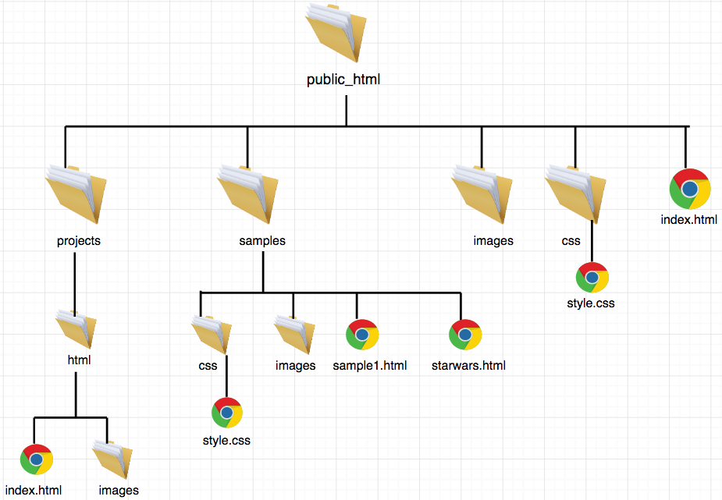
CSS 1
Notes:
<link> element can be used in an HTML document to tell the browser where to find the CSS file used to style the page. lives inside the <head> element.
href - This specifies the path to the CSS file This attribute specifies the type of document being linked to. The value should be text/css.
rel -This specifies the relationship between the HTML page and the file it is linked to. The value should be stylesheet when linking to a CSS file.

Slide 5
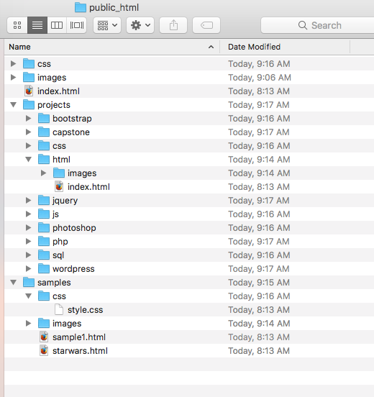
CSS 1
Notes:
<link> element can be used in an HTML document to tell the browser where to find the CSS file used to style the page. lives inside the <head> element.
href - This specifies the path to the CSS file This attribute specifies the type of document being linked to. The value should be text/css.
rel -This specifies the relationship between the HTML page and the file it is linked to. The value should be stylesheet when linking to a CSS file.

Slide 6
CSS Selectors and Styling

Slide 7
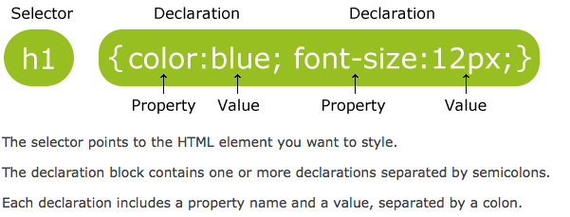
CSS
CSS Style rules are associated with HTML elements and declared in two parts by Selectors and Declarations.
The Selector shows what element to apply the rule or style to

Slide 8
CSS
Selectors -The selector shows what element/html to apply the rule or style to. Same rule can apply to more than one element if you separate the element names with a comma
Selector-html element you want to change(<p> <h1>, <div>, <header>, <nav>, #id, .class)
Declarations- indicate how element should be styled.
Declarations are placed inside braces { } and contain:
Property-Aspect of the element you want to change(font-family, background-color, width, height)
Value- Settings you want to apply (What you want it to be color name, font name, number of pixels)

Slide 9
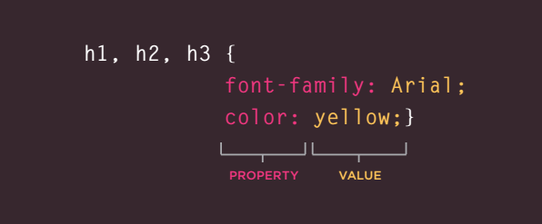
CSS
When styling with CSS you :
Separate more than 1 selector (h1, h2, h3) with a comma ','
Wrap the declaration(s) with curly braces '{', '}'
Separate more than 1 declaration with a semicolon ';'

Slide 10
CSS
Selectors:
Allow you to target rules to specific elements in an HTML document
Can be HTML Tags
Can be IDs
Classes

Slide 11
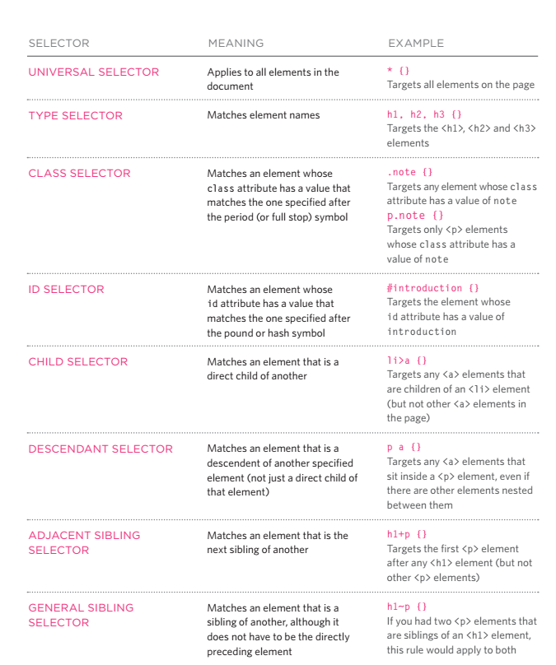
CSS Selectors

Slide 12
CSS Selectors
The ID selector (combined with HTML Element) Unique
We need ways to select tags in an HTML document. The basic elements like <h1>, <p>, and <ul> will often do the job, but our basic set of tags doesn't cover every possible type of page element or layout choice. For this we need ID's and Classes. For example <ul id="nav">, this will give us the chance to target this unordered list specifically, so that we may manipulate it uniquely to other unordered lists on our page.
The ID selector uses the ID attribute of an HTML element to select a specific element
Each element can have only one ID
The ID of an element should be unique within a page, so the ID selector is used to select one unique element
Each page can have only one element with that ID
To select an element with a specific ID, write a hash (#) character, followed by the ID name of the element, e.g.: #news { color: red; }

Slide 13
CSS Selectors
The .class selector (combined with HTML Element)
Selects elements with a specific class attribute
To select elements with a specific class, write a period (.) character, followed by the name of the class in your CSS stylesheet or within your styling rule
You can also specify that only specific HTML elements should be affected by a class. To do this, start with the element name, then write the period (.) character, followed by the name of the class
You can use the same class on multiple elements (those elements usually have same CSS Properties and Values).
You can use multiple classes on the same HTML element.
Any styling information that needs to be applied to multiple objects on a page should be done with a class.

Slide 14
CSS Selectors
The id Selector and The .class selector
Can be combined with HTML Element to apply styling
ID - #news { color: red; } CLASS- .news { color: red; }
If you want higher specificity, you can combine both the element and ID selectors:
ID - li#news { color: red; } CLASS- li.news { color: red; }

Slide 15
CSS Selectors
The .class selector
Let’s say you had a class widget?
You can now use the class name "widget" as your hook to apply the same set of styling to each one of these. But what if you need one of them to be bigger than the other, but still share all the other attributes? You can apply more than one class to the element:
<div class="widget"></div> <div class="widget big"></div> <div class="widget"></div>
You do not need to make a brand new class name here, just apply a new class right in the class attribute. These classes are space delimited and most browsers support any number of them (actually, it's more like thousands, but way more than you'll ever need).
<div class="widget"></div> <div class="widget big"></div> <div class="widget"></div>

Slide 16
CSS Selectors
NOTE: Classes have no special abilities in the browser, but ID's do have one very important trick up their sleeve. This is the "hash value" in the URL.
If you have a URL like http://yourdomain.com#comments, the browser will attempt to locate the element with an ID of "comments" and will automatically scroll the page to show that element. It is important to note here that the browser will scroll whatever element it needs to in order to show that element, so if you did something special like a scrollable DIV area within your regular body, that div will be scrolled too.
This is an important reason why having ID's be absolutely unique is important. So your browser knows where to scroll!

Slide 17
CSS
Placement and Parts

Slide 18
CSS
Review on Parts to Styling
Based on Declarations, Properties, and Values
Insert into your HTML source code using 3 possible ways:
Inline: In the HTML element or tag <h1 style=“color:red;”>heading text</h1>
Internal: In the HTML page between the head tags <head><style>h1 {color:red;}</style></head>
External: In a separate document <head><link rel="stylesheet" type="text/css" href="css/mystyle.css"></head>
Inline is written directly into the html <> tag and/or html element
Internal is written/defined in between the <head><style>HERE</style></head> tags then by referencing HTML Element/Selector or tag in the body of the page.
External is written/defined in a separate document, linked to CSS document in between the <head></head> tags +/combined HTML Element/selector in the body of the page -written in external document excludes the <style></style> (Preferred Method), e.g. <head><link rel=”stylesheet” type=”text/css” href=”style.css”></head>
When using Internal or External CSS your Declarations Properties and Values coincide with your HTML structure. (EXAMPLE:) HTML Syntax -<h1>Heading</h1> CSS Syntax - h1 {color:red;}

Slide 19
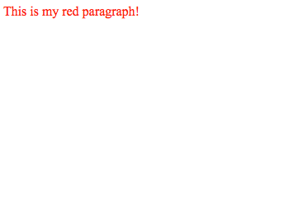
CSS
In-line styling -Inside HTML Page affecting a single HTML Element
HTML Page: Result:
<!doctype html>
<html>
<head>
<meta charset="UTF-8">
<title>In-Line Style</title>
</head>
<body>
<p style="color:#F9080C;"> This is my red paragraph!</p>
</body>
</html>

Slide 20
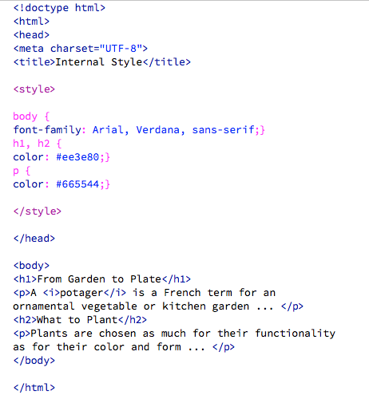
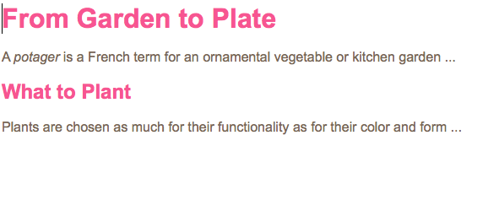
CSS Internal
Internal styling -Inside HTML Page Head Tags using <head><style></style></head>
HTML Page:
Result:

Slide 21
CSS
External style sheets should not contain <style></style> inside the CSS document. Just use the selector / element {}, then declarations, attributes and values.
CSS Stylesheet Syntax should look like (Below):
Can link more than one stylesheet in the <head>of the HTML page
<head> <link rel=“stylesheet” type=“text/css” href=“css/stylesheetname.css”></head>
@charset "UTF-8";
/* CSS Document */
body {
font-family: arial;
background-color: blue;}
h1 {
color: black;}
href-tells browser where the CSS document is:
type- defines type of document you are linking to
rel- defines relationship of the document to the HTML page

Slide 22
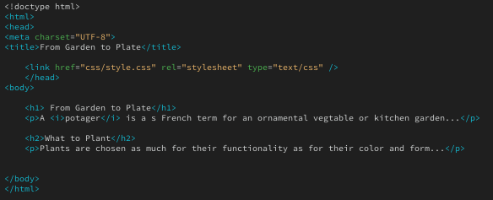
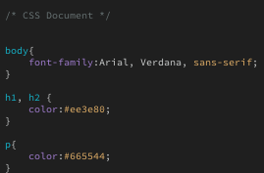
CSS Internal
External Styling
HTML Page:
CSS Page:
Result:

Slide 23

CSS
TERMINOLOGY - CSS Stylesheet Pages
UTF-8 is a compromise character encoding that can be as compact as ASCII (if the file is just plain English text) but can also contain any unicode characters (with some increase in file size). UTF stands for Unicode Transformation Format. The '8' means it uses 8-bit blocks to represent a character.
UTF-8 is backwards compatible with ASCII. UTF-8 is the preferred encoding for web pages.
@charset at the beginning of the CSS document tells the browser to read the CSS file as UTF-8. This is handy if your CSS contains unicode character encoding or processing, storage, and transport of text characters. The default for HTML 5 is UTF-8.
Basis for use: If you have any non-ASCII text in your CSS file, for example non-ASCII characters in font names, in values of the content property, in selectors (ex , ) etc., you need to be sure that the CSS parser knows how to transform the bytes into characters correctly, so that it understands your CSS or HTML code.

Slide 24
CSS
Exercise

Slide 25
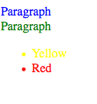
CSS Selectors
Create a page called divs2.html with external styling (divs2.css). Add 2 divs: one with an id and one with a class name. Place the word “paragraph” inside both of the divs, and save the file to the public_html/class-samples directory.
Give the first div (with an id) a text color of blue
Give the second div (with a class) a text color of green
Add an unordered list with 2 list items (yellow and red)
Create an id for each list item selector
Style the first id with a text color of yellow
Style the second id with a text color red

Slide 26
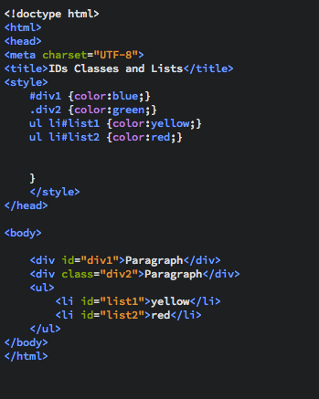
CSS Selectors

Slide 27
CSS
Exercise

Slide 28
Inserting External CSS
Create a page called external.html with external styling page called mystyle.css
save the html page into public_html/class-samples directory
save the css page into public_html/class-samples/css directory
Preview Result Should Look Like this:
Notes:
<link> element can be used in an HTML document to tell the browser where to find the CSS file used to style the page. lives inside the <head> element.
href - This specifies the path to the CSS file This attribute specifies the type of document being linked to. The value should be text/css.
rel -This specifies the relationship between the HTML page and the file it is linked to. The value should be stylesheet when linking to a CSS file.

Slide 29
Color

Slide 30
CSS 1
Options for Applying Colors
Color Name: (red, blue etc.)
#rrggbb - six hexadecimal digits specify the components of the color, e.g. #fce263
rgb(r,g,b) - three integers (0-255) representing red, green, and blue, e.g. rgb(14,51,98)
rgba(r,g,b,a) - same as above, but with an additional alpha component (opacity) 0.0-1.0, e.g. rgba(14,51,98,0.7)
hsl(120, 100%, 50%) Hue, Saturation, Lightness
hsla(120, 100%, 50% , 1.0) Hue, Saturation, Lightness, Alpha
https://www.w3schools.com/cssref/css_colors_legal.asp
Notes:
<link> element can be used in an HTML document to tell the browser where to find the CSS file used to style the page. lives inside the <head> element.
href - This specifies the path to the CSS file This attribute specifies the type of document being linked to. The value should be text/css.
rel -This specifies the relationship between the HTML page and the file it is linked to. The value should be stylesheet when linking to a CSS file.

Slide 31
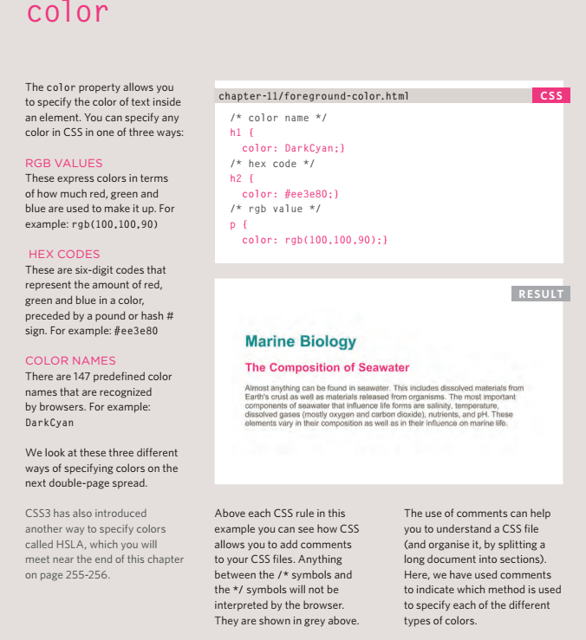
CSS
Applying Color and Opacity:
RGB -Based on RGB Numbers
RGB color values are supported in all major browsers.
RGBA -Red Green Blue Alpha
RGBA color values are supported in IE9+, Firefox 3+, Chrome, Safari, and in Opera 10+.
RGBA color values are an extension of RGB color values with an alpha channel - which specifies the opacity of the object.
An RGBA color value is specified with: rgba(red, green, blue, alpha). The alpha parameter is a number between 0.0 (fully transparent) and 1.0 (fully opaque).
HEX Code- Can use last 3 Octets with #
Hexadecimal color values are supported in all major browsers.
HSL, HSLA hue, saturation, and lightness
Hue is a degree on the color wheel (from 0 to 360) - 0 (or 360) is red, 120 is green, 240 is blue. Saturation is a percentage value; 0% means a shade of gray and 100% is the full color. Lightness is also a percentage; 0% is black, 100% is white.
Color Names- Not recommended (147 Supported)

Slide 32
CSS
Applying Color and Opacity:
HTML Selector/ID or Class { color: ColorValue;}
HTML Selector/ID or Class { background-color: ColorValue;}
CSS3 introduces the opacity property which allows you to specify the opacity of an element and any of its child elements.
The value is a number between 0.0 and 1.0 (so a value of 0.5 is 50% opacity and 0.15 is 15% opacity).
HTML Selector/ID or Class { opacity: 0.5;}
Use Hex unless specifying opacity or in need of the Alpha Channel

Slide 33
CSS
Color Type HEX - (#000000)
HEX - A hexadecimal color is specified with: #RRGGBB, where the RR (red), GG (green) and BB (blue) hexadecimal integers specify the components of the color. All values must be between 00 and FF.
Note: Browser Supported

Slide 34
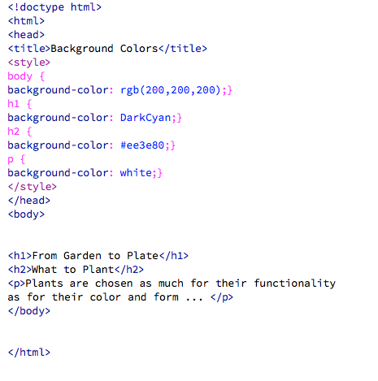
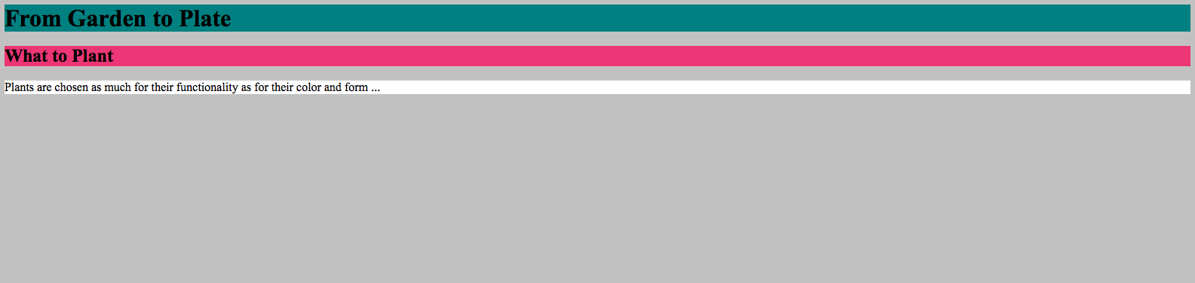
CSS
HTML Page
Preview Result

Slide 35
CSS
HTML Page
Preview Result

Slide 36
CSS
Color Type RGB - (255, 0, 0)
RGB -An RGB color value is specified with the rgb() function, which has the following syntax:
rgb(red, green, blue)
Each parameter (red, green, and blue) defines the intensity of the color and can be an integer between 0 and 255 or a percentage value (from 0% to 100%).
For example, the rgb(0,0,255) value is rendered as blue, because the blue parameter is set to its highest value (255) and the others are set to 0.
Also, the following values define equal color: rgb(0,0,255) and rgb(0%,0%,100%).
Note: Browser Supported

Slide 37
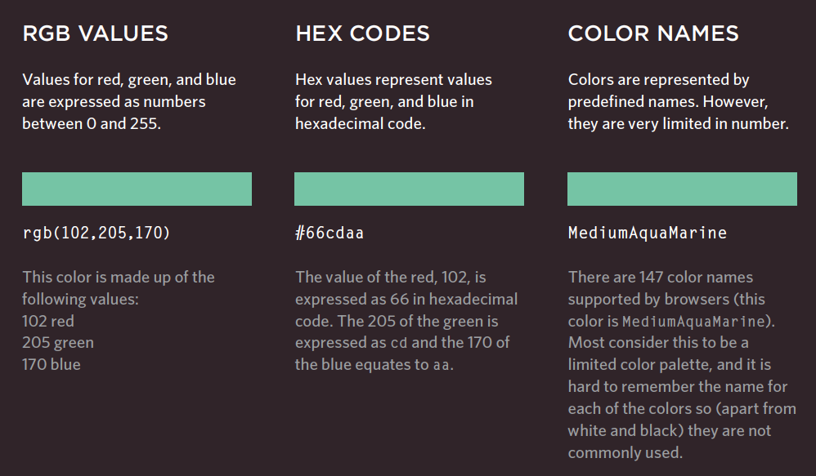
CSS
Color Declarations-Based on Red, Green, Blue, Alpha
rgba stands for
red green blue alpha.
rgba(255, 0, 0, 0.3)
While it is sometimes described as a color space, it is actually simply a use of the RGB color model, with extra information.
Opacity can be combined/changed using a 4th value rgba

Slide 38
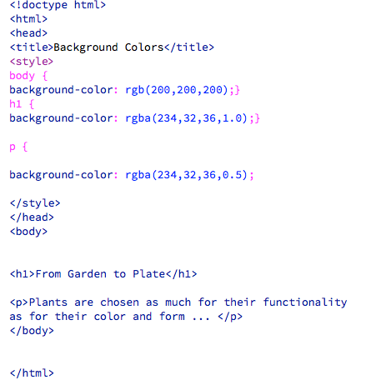
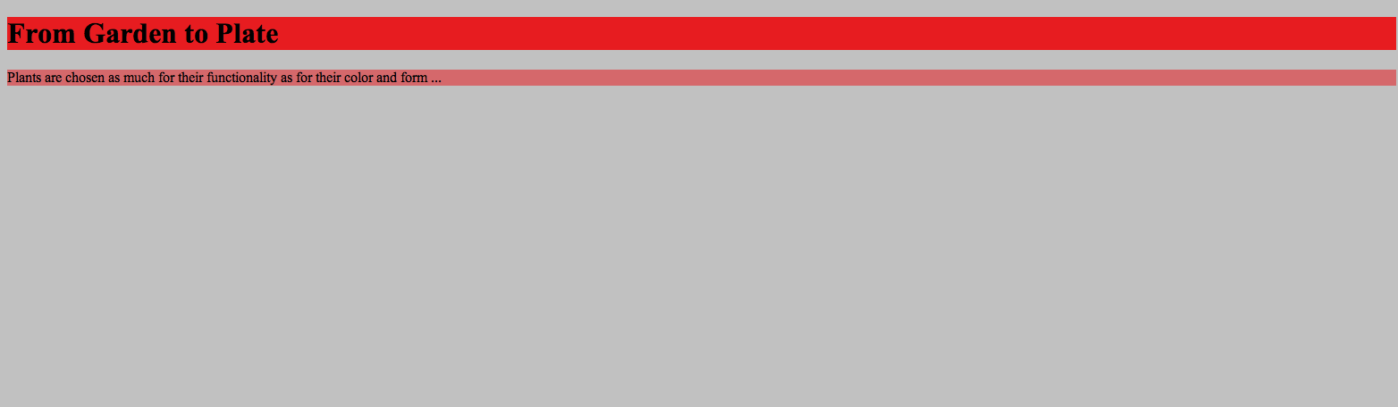
CSS
Setting Opacity - (1.0 Full or 0.5 half)
HTML Page
Preview Result
}

Slide 39
CSS
Color Type HSL, HSLA - (0.75 = 75% or 0.5 = 50%)
HSL stands for (hue, saturation, and lightness) - and represents a cylindrical-coordinate representation of colors.
An HSL color value is specified with: hsl(hue, saturation, lightness). hsl(120, 100%, 50%)
Hue is a degree on the color wheel (from 0 to 360) - 0 (or 360) is red, 120 is green, 240 is blue. Saturation is a percentage value; 0% means a shade of gray and 100% is the full color. Lightness is also a percentage; 0% is black, 100% is white.
An HSLA color value is specified with: hsla(hue, saturation, lightness, alpha), where the alpha parameter defines the opacity. hsla(120, 100%, 50%, 0.3)
The alpha parameter is a number between 0.0 (fully transparent) and 1.0 (fully opaque).
Note: Limited Support be careful of browser versions

Slide 40
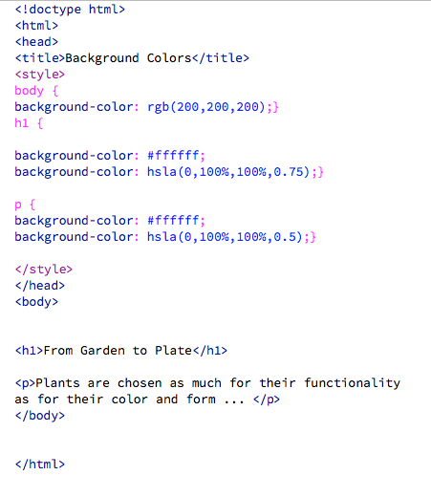
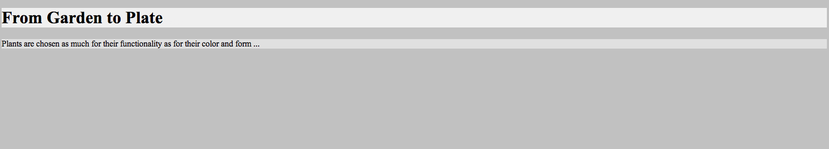
CSS
Color Type HSL, HSLA - (0.75 = 75% or 0.5 = 50%)
HTML Page
Preview Result

Slide 41
CSS
Color Charts:
http://www.rapidtables.com/web/color/RGB_Color.htm
http://www.w3schools.com/cssref/css_colors.asp
http://hslpicker.com/

Slide 42
Text

Slide 43
CSS
Applying Fonts and Text Style (attributes):
Options:
Font family (font-family)
Reference a URL
Size (font-size)
Percentage (%)
Pixel (px)
em -width of the letter m (em)
Pt -points
Weight (font-weight, bold or normal)
Style (font-style: italic or normal)
Transform (text-transform)
Decoration (text-decoration)
Spacing (letter-spacing, word-spacing)
Align (text-align)
Indent (text-indent)
Shadow (text-shadow)
NOTE: Set Font Size With Em
To allow users to resize the text (in the browser menu), many developers use em instead of pixels.
The em size unit is recommended by the W3C.
1em is equal to the current font size. The default text size in browsers is 16px. So, the default size of 1em is 16px.
The size can be calculated from pixels to em using this formula: pixels/16=em

Slide 44
CSS TEXT
Applying Fonts and Text Style (Syntax):
font-family Serif, Verdana, Times
font-size
Percentage (%) font-size: 100%;
Pixel (px) font-size: 30px;
EM (em) -width of the letter -based on parent font-size: 1.0em;
Reference a URL- @font-face; src: url('fonts/chunkfive.eot');}
font-weight bold/normal
font-style italic/normal/oblique;
text-transform uppercase/lowercase/capitalize
text-decoration none/underline/overline/line-through/blink
letter-spacing (0.5em) or word-spacing (0.5em)
text-align
text-align left/right/justify
vertical-align: top/baseline/bottom ;
text-indent 20px
text-shadow 1px -1px #666666

Slide 45
CSS
Syntax:
HTML Selector/ID or Class {font-family: serif, arial, helvetica;}
HTML Selector/ID or Class {font-size: 10px;}
HTML Selector/ID or Class {font-weight: bold;}
@font-face {
font-family: 'ChunkFiveRegular';
src: url('fonts/chunkfive.eot');}
must first define a name for the font (e.g. myFirstFont), and then point to the font file.
HTML Selector/ID or Class {font-style: italic;}
HTML Selector/ID or Class {text-transform: uppercase;}
HTML Selector/ID or Class {text-decoration: none;}

Slide 46
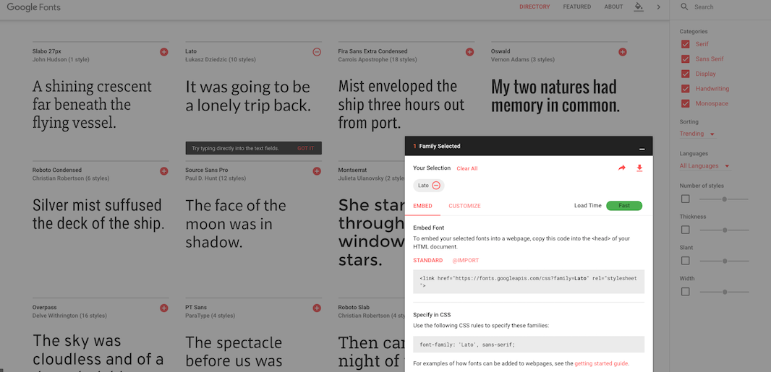
CSS
Linking out/Embedding a font library and applying it to your css internal style
Google Fonts: https://developers.google.com/fonts/
Click the +
Click the - to maximize the link source
Paste the link source between the <head></head> tags

Slide 47
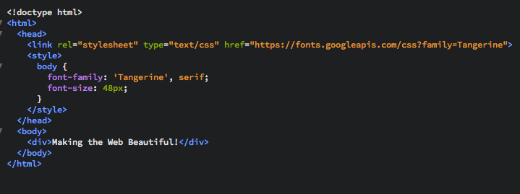
CSS
Linking out to a font library and applying it to your css internal style

Slide 48
CSS
Find Out What Font is on a page or image
https://www.myfonts.com/WhatTheFont/

Slide 49
CSS
HTML Selector/ID or Class {
color: #666666;
text-shadow: 1px 1px 0px #000000;}
Syntax For Making Text Shadow:

Slide 50
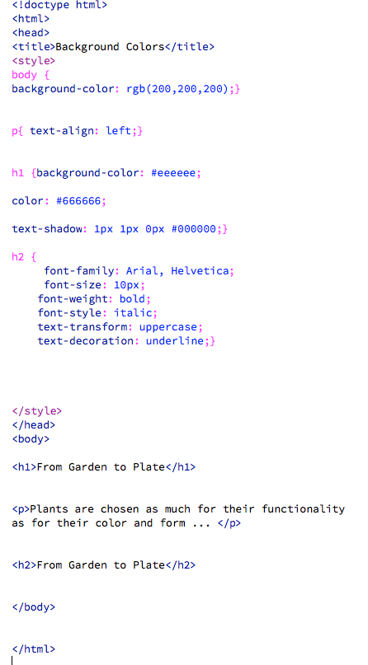
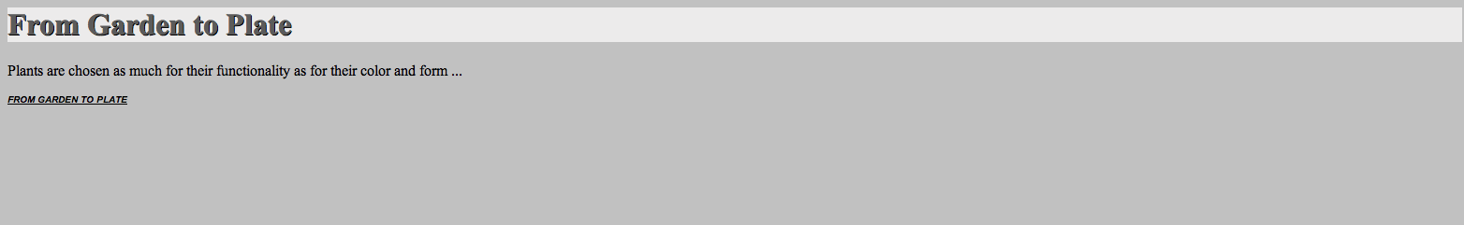
CSS
HTML PAGE:
Preview Result:

Slide 51
CSS
Styling Links
Link
Active
Visited
Hover
a:link {
color: deeppink;
text-decoration: none;}
a:visited {
color: black;}
a:hover {
color: blue;
text-decoration: underline;}
a:active {
color: darkcyan;}
HTML
<a href=“#”>link</a>
CSS
a:link {
color:deeppink; text-decoration:none;
}

Slide 52
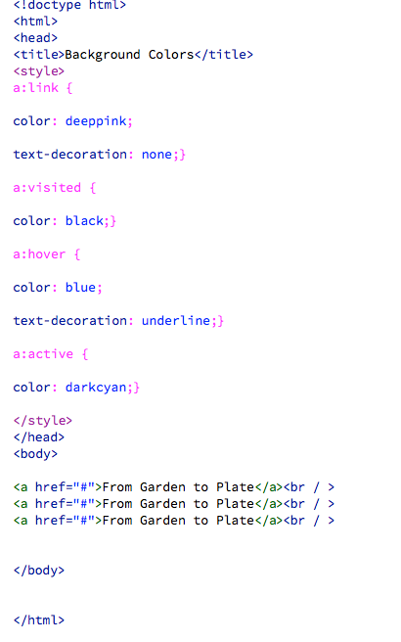
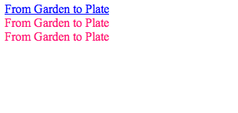
CSS
HTML PAGE:
Result as you hover a link:

Slide 53
Boxes & Layouts

Slide 54
CSS Blocks
Layout Methods
Tables -Used in past for page layouts and currently for HTML email or tabular data (Uses HTML)
The Normal Flow (Uses CSS + Divs, HTML 5)
Floats (Uses CSS+ DIVS and or HTML5)
Other Methods
Positioning (Uses CSS)
Flexbox (Support Limited)
Grid (Support Limited)

Slide 55
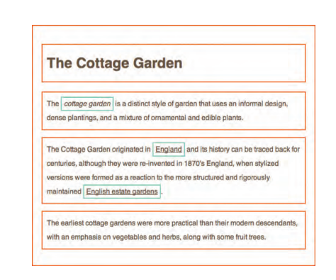
CSS Box
DIVs, and HTML 5 Semantic Grouping :
CSS allows you to create rules that control the way that each individual box (and the contents of that box) is presented.
In this case you can style content inside each box or the box itself including:
Background Color
Text Font
Border Color
Its position in the browser
The CSS Box Model. All HTML elements can be considered as boxes. In CSS, the term "box model" is used when talking about design and layout. The CSS box model is essentially a box that wraps around HTML elements, and it consists of: margins, borders, padding, and the actual content.

Slide 56
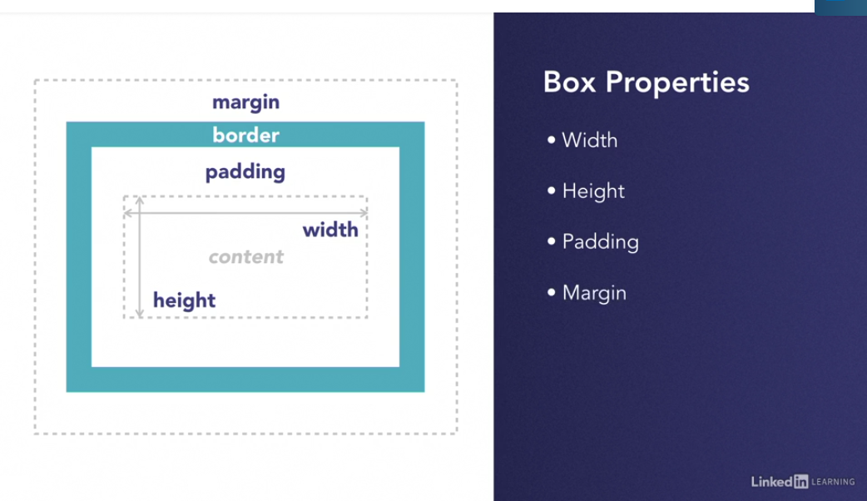
CSS Box
Boxes and Box Model
CSS allows you to create rules that control the way that each individual box (and the contents of that box) is presented.
Width-Sets the width of the content area which is the actual content between the tags
Height-Sets the height of the content area which is the actual content between the tags
Padding- add the space within and element
Margin- Add or remove the space around the element
Border-is added between margin and padding

Slide 57
CSS Blocks
The Normal Flow
Block Elements
The normal flow of elements on a page will appear as they are written in the HTML code. Normal elements will appear stacked on one another and are called block elements.
CSS moves away from the normal flow to create columns and rows, placing elements in specific areas of the page.
Block elements assume the size as the content between their tags

Slide 58
CSS Blocks
The Normal Flow
Inline Elements
Inline elements take up the same space as the content contained in their tags.
The elements align side by side, starting from the left, as long as there's space inside of the containing element. If there isn't enough space, then the text or elements will move down to a new line.
If you add a background to the element you can tell what type of element it is. If the color stretches the width of the container, it's a block element. If it only spans the size of the content, then it's an inline element.

Slide 59
CSS Blocks
Boxes Normal Flow Layout -Method #2
HTML IDs, or Class can be used for marking up boxes grouping content and for layouts using <div></div> together with CSS syntax
HTML CSS
<div class= “nav”></div> .nav {
width:1024px;
height: 300px;
}

Slide 60
CSS Boxes
We use html(5) selectors, classes or ids to define containers or boxes and use divs or html5 semantic grouping elements to group them
Attributes for boxes:
width in pixels -(px) or percentages (%) HTML Selector/ID or Class {width: 1000px;}
height in pixels- (px) or percentages (%) HTML Selector/ID or Class {height: 1000px;}
background color-(box background) HTML Selector/ID or Class {background-color: red;}
border:
placement -(top, right, bottom, left) HTML Selector/ID or Class { border-top-style:dotted;}
width -(thick, medium thin) HTML Selector/ID or Class { border-width:medium;}
style- (solid, dotted, dashed, double, groove, ridge, inset, outset)
HTML Selector/ID or Class { border-style:dotted;}
color (text color inside the box) - HTML Selector/ID or Class {color: red;}
border-color HTML Selector/ID or Class {border-color: red;}
padding - (space between inside border and content in the box)
HTML Selector/ID or Class {padding:0px 0px 1px 2px;}
margins - (space outside the border) HTML Selector/ID or Class {margin: 0px 0px 1px 2px;}
float - (where the box is positioned) HTML Selector/ID or Class {float:left;}
clear - (returns to the next line or clears one side) HTML Selector/ID or Class {clear:both;}

Slide 61
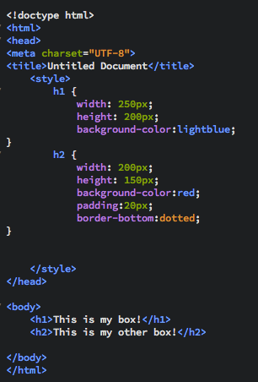
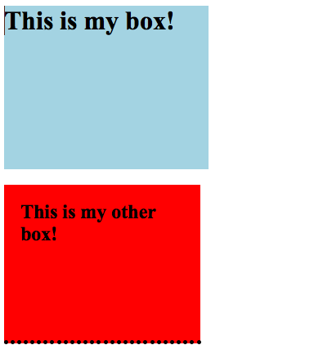
CSS Boxes
HTML PAGE:
Preview Result:

Slide 62
CSS Boxes
Box Formatting Options
Padding -Places space within and element
Same for border which is between margin and padding - (top ,right, bottom, left)
HTML Selector/ID or Class { padding: 1px 5px 3px 1px; }
HTML Selector/ID or Class { padding-left: 1px; }
Margin -Places around an element
Same as padding/border - (top ,right bottom left)
HTML Selector/ID or Class {margin-left: 10px;}
HTML Selector/ID or Class {margin: 10px 10px 10px 10px; }
NOTE:
If you want to center a box on the page horizontally (or center it inside the container that it sits in), you can set the left-margin and right-margin to auto. This must also be combined with the width property
HTML Selector/ID or Class {
margin: 10px auto 10px auto; }
Or
HTML Selector/ID or Class {
margin: 0 auto;}

Slide 63
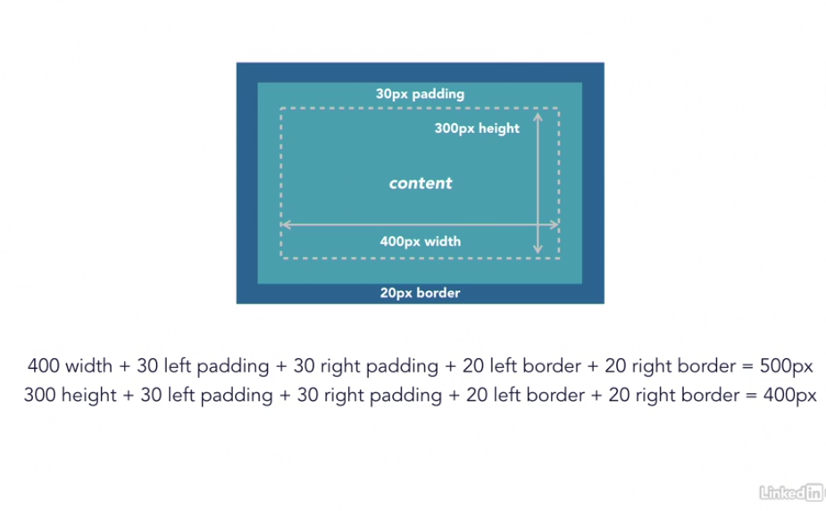
CSS Boxes
Box Formatting Options
***Remember All elements increase in size when adjusting any of the properties

Slide 64
CSS Boxes
Box Normal Flow -Locations
Float -specifies whether or not an element should float and where. Elements after a floating element will flow or fill around it (none, left, right, inherit)
HTML Selector/ID or Class { float: left; }
Clear -is used to control the behavior of the floating elements property anc will clear the float so it does not wrap. Also specifies on which side of an element floating elements are not allowed to float( left, right, both, none)
HTML Selector/ID or Class { clear: both;}

Slide 65
CSS Boxes
Rendering
-Moz and Webkit are a web browser rendering, rendering engine used by Safari and Chrome (among others, but these are the popular ones). The -webkit prefix on CSS selectors are properties that only this engine is intended to process, very similar to -moz properties.
These are the vendor-prefixed properties offered by the relevant rendering engines (-webkit for Chrome and Safari; -moz for Firefox, -o for Opera, -ms for Internet Explorer). Typically they're used to implement new, or proprietary CSS features, prior to final clarification/definition by the W3.
This allows properties to be set specific to each individual browser/rendering engine in order for inconsistencies between implementations to be safely accounted for. The prefixes will, over time, be removed (at least in theory) as the unprefixed, the final version, of the property is implemented in that browser.

Slide 66
CSS Boxes
Additional Box Formatting
border-radius Sets the corners of the box
box-shadow creates a shadow on the box (needs size and color attributes)
CSS Syntax:
HTML Selector/ID or Class {
width: 300px;
height: 100px;
background-color: yellow;
box-shadow: 10px 10px 5px #888888;
}
CSS Syntax:
HTML Selector/ID or Class{
border: 5px solid #cccccc;
border-radius: 10px;
-moz-border-radius: 10px;
-webkit-border-radius: 10px;
}
Browser Support:

Slide 67
CSS Blocks
CSS Block and Inline Elements
display element is used for HTML Selector/ID or Class to change the behavior of elements in the normal flow
display:inline;
display:none;
display:block
display:inline-block
used with block elements like <ul><li></li></ul> to make them display inline
If used with and inline element like <span></span> the inline element would ignore width and height unless you use display:block;
If using display:inline-block it will apply characteristics of both inline and block

Slide 68
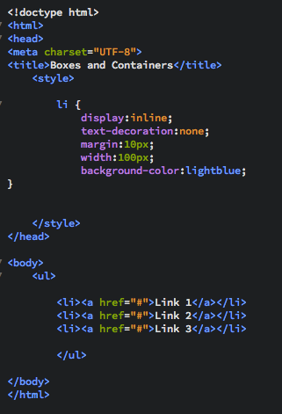

CSS Blocks
HTML PAGE:
Preview Result:

Slide 69
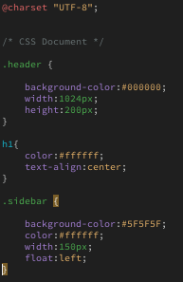
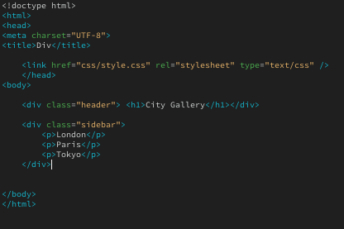
HTML and CSS
HTML PAGE:
CSS:

Slide 70

HTML and CSS
Result:

Slide 71
CSS Blocks
Method #3
HTML 5 Selectors/ IDs, or Class can be used for marking up boxes grouping content and for layouts similar to <div></div>
<header></header>
<nav></nav>
<main></main>
<section></section>
<article></article>
<aside></aside>
<footer></footer>

Slide 72
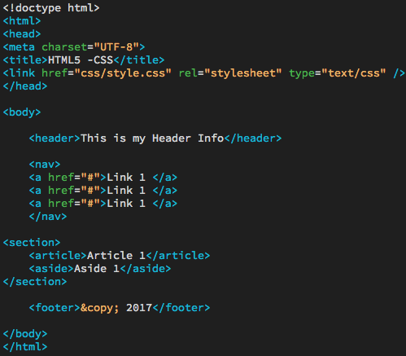
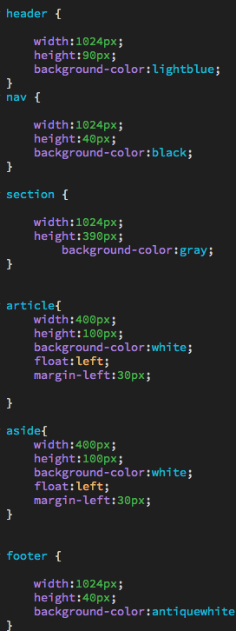
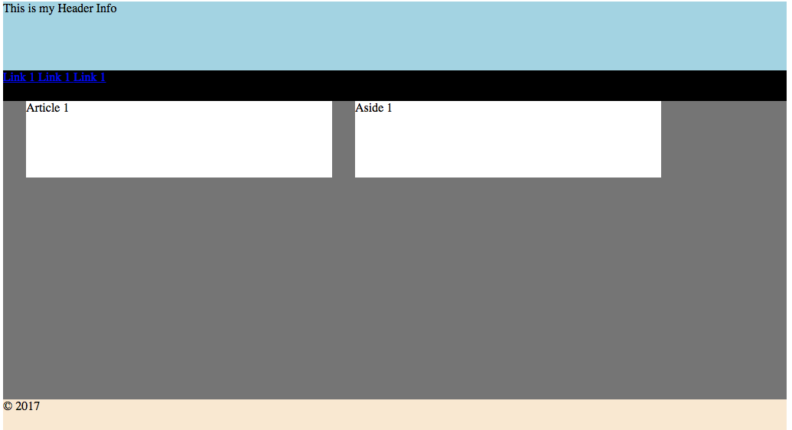
HTML 5 and CSS
HTML PAGE:
CSS:
Result:

Slide 73
HTML 5 and CSS

Slide 74
CSS
Exercise

Slide 75
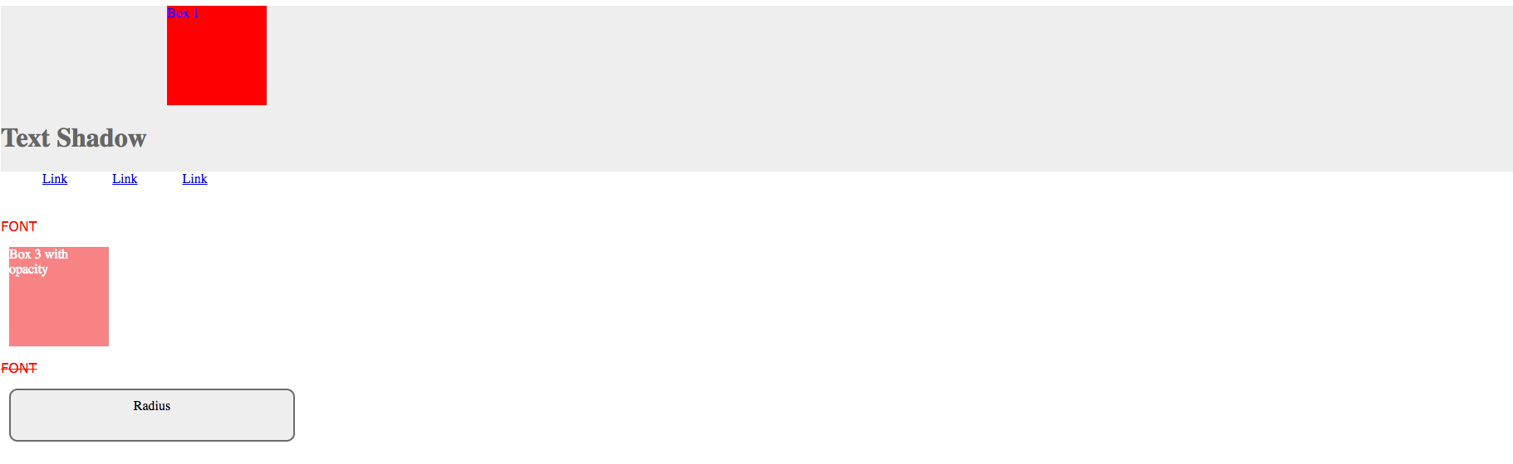
CSS
Create a new HTML page called css1.html that looks similar to this
Link the HTML page to an external stylesheet called style3.css (links should change color when you hover over them)
Place HTML Page in public_html/class-samples/ folder
Save the style3.css page in public_html/class-samples/css folder
Notes:
<link> element can be used in an HTML document to tell the browser where to find the CSS file used to style the page. lives inside the <head> element.
href - This specifies the path to the CSS file This attribute specifies the type of document being linked to. The value should be text/css.
rel -This specifies the relationship between the HTML page and the file it is linked to. The value should be stylesheet when linking to a CSS file.

Slide 76
CSS
Create part of the Cartoon Network website in the next slide using HTML 5 and CSS- (Instructor will send images)
Name the page cartoon.html and save it to public_html/class-samples/
Link the CSS page to an external stylesheet called cartoon.css and save it to public_html/class-samples/css
Links on page should hover light blue when mouse passes over them.
Upload the images, cartoon.css and cartoon.html files up to the web server and send the instructor the link
Notes:
<link> element can be used in an HTML document to tell the browser where to find the CSS file used to style the page. lives inside the <head> element.
href - This specifies the path to the CSS file This attribute specifies the type of document being linked to. The value should be text/css.
rel -This specifies the relationship between the HTML page and the file it is linked to. The value should be stylesheet when linking to a CSS file.

Slide 77
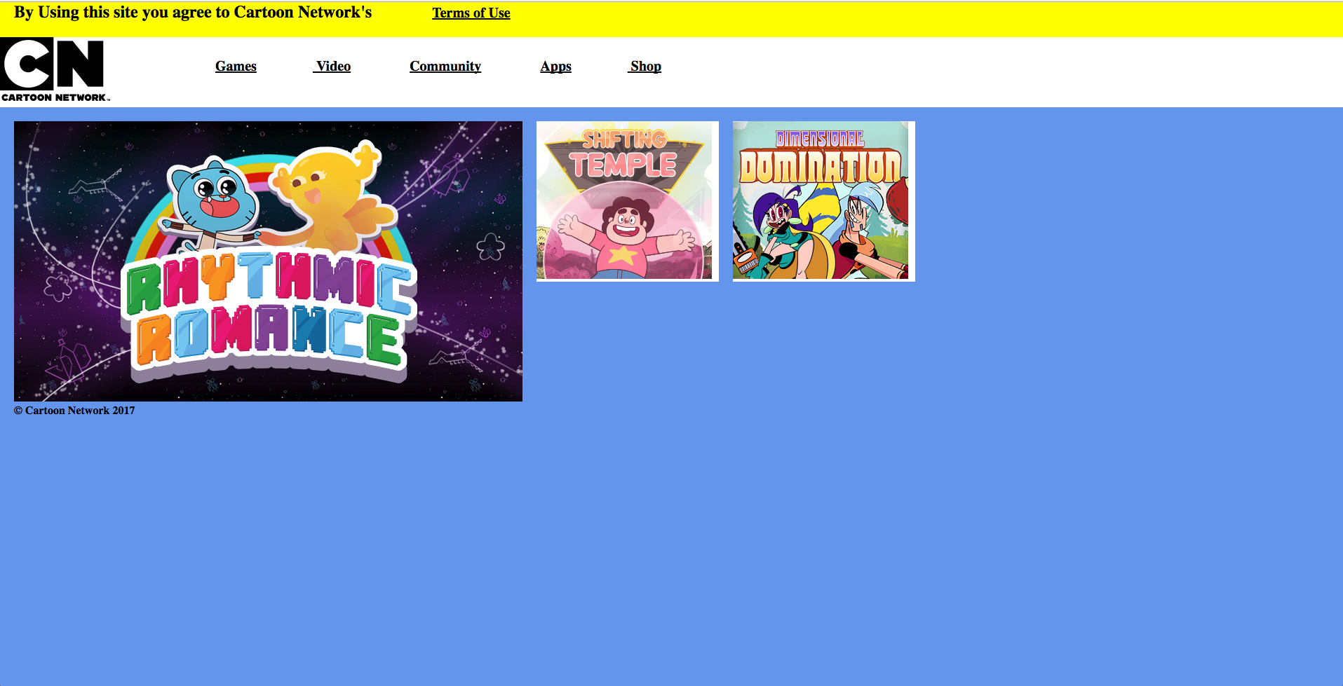
CSS

Slide 78
Homework
HOMEWORK:
Finish Safety html project and email link to me.
Finish Cartoon CSS sample and post to web server (email the link to me)
public_html/class-samples/cartoon.html
Finish https://teamtreehouse.com/library/how-to-make-a-website
Start https://teamtreehouse.com/library/introduction-to-html-and-css
Start CSS Basics https://teamtreehouse.com/library/css-basics
Practice CSS and HTML
Notes:
<link> element can be used in an HTML document to tell the browser where to find the CSS file used to style the page. lives inside the <head> element.
href - This specifies the path to the CSS file This attribute specifies the type of document being linked to. The value should be text/css.
rel -This specifies the relationship between the HTML page and the file it is linked to. The value should be stylesheet when linking to a CSS file.

Slide 79
End

